Slide 1



Tinkering Bootcamp
Week 1-Session 2
Introduction to Arduino

Slide 2
What we are going to cover today?
Recap
Digital Pins
Analog Pins
PWM pins
Sensors
Servo Motors
Ultrasonic Sensor

Slide 3
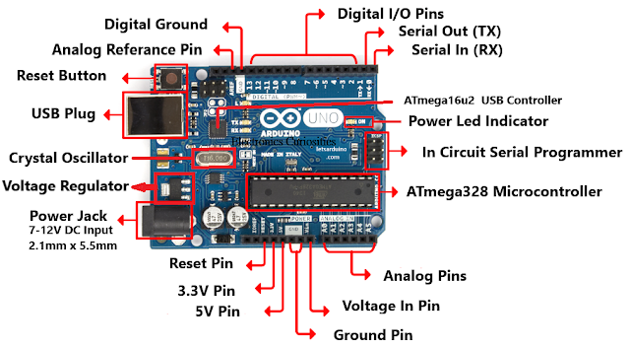
Recap
Pins on Arduino:-
Arduino Uno has 14 digital input/output pins (out of which 6 can be used as PWM outputs), 6 analog input pins.
ATmega328:-
Brain of the Arduino
Digital Pins:-Pins, which have only 2 values
0(LOW) or 1(HIGH) for output/input
Analog Pins:-They take inputs in the form of Analog Signal and return values between 0 and 1023(that’s because the arduino uno has a 10 bit Analog to Digital converter, or 2¹⁰ resolutions.)

Slide 4
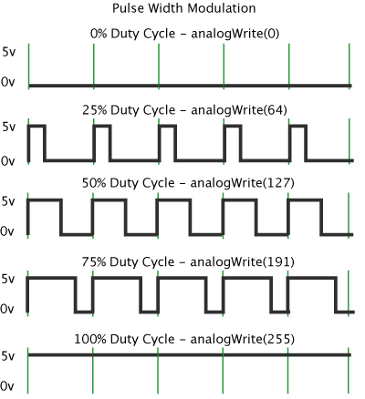
PWM Pins:-
Pulse Width Modulation, or PWM, is a technique for getting analog results with digital means. Digital control is used to create a square wave, a signal switched between on and off.
A call to analogWrite() is on a scale of 0 - 255,
such that analogWrite(255) requests a 100% duty
cycle (always on), and analogWrite(127) is a 50%
duty cycle (on half the time) for example.
Picture Credits:-https://www.arduino.cc/en/tutorial/PWM#:~:text=Pulse%20Width%20Modulation%2C%20or%20P
WM,switched%20between%20on%20and%20off.

Slide 5
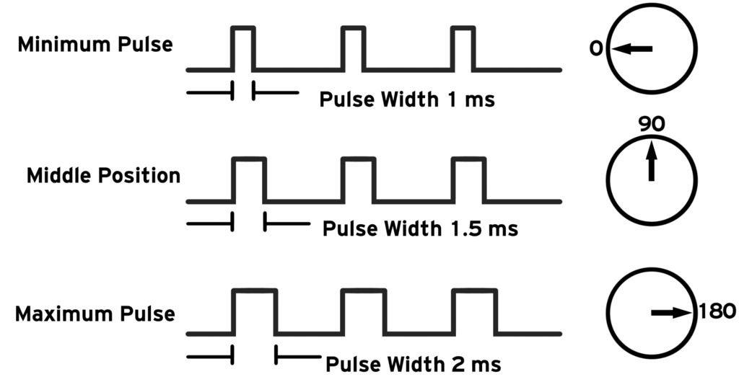
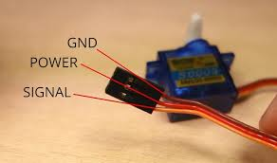
Now we will learn about 2 different types of sensors:-
Servo motors:-Servo motors are great devices that can turn to a specified position.Usually, they have a servo arm that can turn 180 degrees.
Servos are clever devices. Using just one input pin, they receive the position from the Arduino and they go there. Internally, they have a motor driver and a feedback circuit that makes sure that the servo arm reaches the desired position. But what kind of signal do they receive on the input pin?
It is a square wave similar to PWM. Each cycle in the signal lasts for 20 milliseconds and for most of the time, the value is LOW. At the beginning of each cycle, the signal is HIGH for a time between 1 and 2 milliseconds. At 1 millisecond it represents 0 degrees and at 2 milliseconds it represents 180 degrees. In between, it represents the value from 0–180. This is a very good and reliable method. The graphic makes it a little easier to understand.

Slide 6
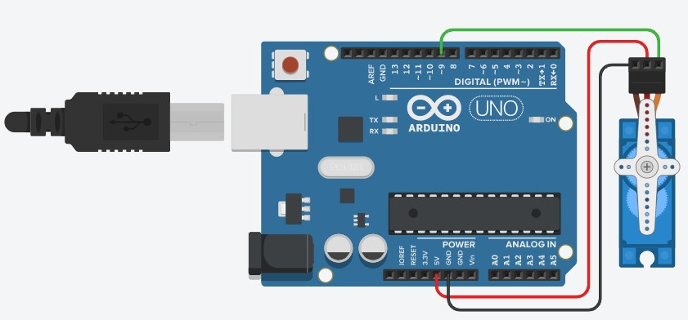
Circuit Diagram for connections

Slide 7
Code to rotate Servo 180 degrees back and forth
#include <Servo.h> //this library is necessary to
//Include in your code
int pos = 0;
Servo servo_9; //creating the object of the servo
void setup()
{
servo_9.attach(9); //To which pin is the signal wire
} //attached to arduino pin
void loop()
{
// sweep the servo from 0 to 180 degrees in steps of 1 degrees
for (pos = 0; pos <= 180; pos += 1) {
// tell servo to go to position in variable 'pos'
servo_9.write(pos);
// wait 15 ms for servo to reach the position
delay(15); // Wait for 15 millisecond(s)
}
for (pos = 180; pos >= 0; pos -= 1) {
// tell servo to go to position in variable 'pos'
servo_9.write(pos);
// wait 15 ms for servo to reach the position
delay(15); // Wait for 15 millisecond(s)
}
}

Slide 8
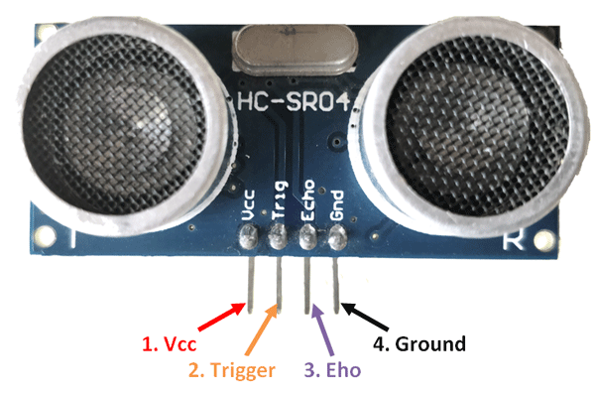
2) Ultrasonic Sensor:- It is a sensor used to detect distances using the principle of reflection of sound waves. It converts electrical energy into acoustic waves and vice versa. It has 4 pins:-
Sr.No | Pin | Function
1 | Vcc | The Vcc pin powers the sensor, typically with +5V
2 | Trigger | Trigger pin is an Input pin. This pin has to be kept high for 10us to initialize measurement by sending US wave.
3 | Echo | Echo pin is an Output pin. This pin goes high for a period of time which will be equal to the time taken for the US wave to return back to the sensor.
4 | Ground | This pin is connected to the Ground of the system.

Slide 9
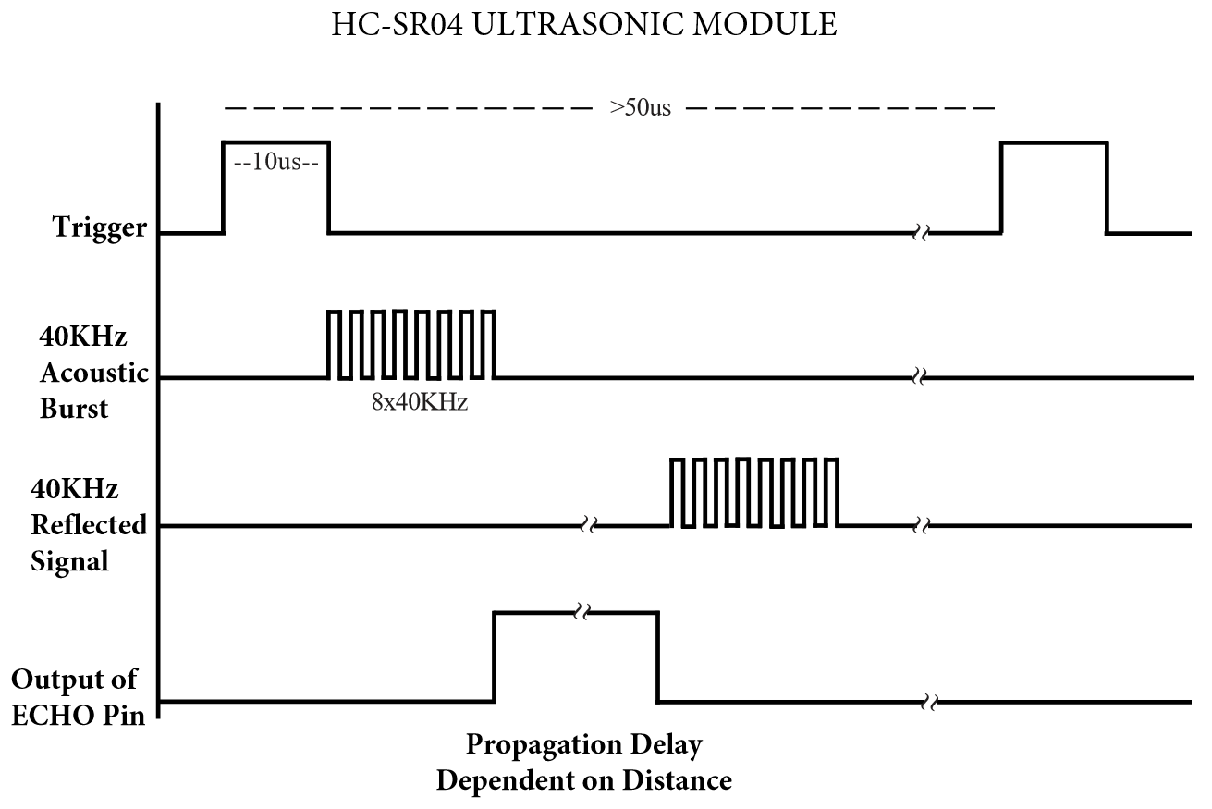
Working:-
The microcontroller sends a trigger signal to the ultrasonic sensor. The duty cycle of this trigger signal is 10µS for the HC-SR04 ultrasonic sensor. When triggered, the ultrasonic sensor generates eight acoustic (ultrasonic) wave bursts and initiates a time counter. As soon as the reflected (echo) signal is received, the timer stops. The output of the ultrasonic sensor is a high pulse with the same duration as the time difference between transmitted ultrasonic bursts and the received echo signal.

Slide 10
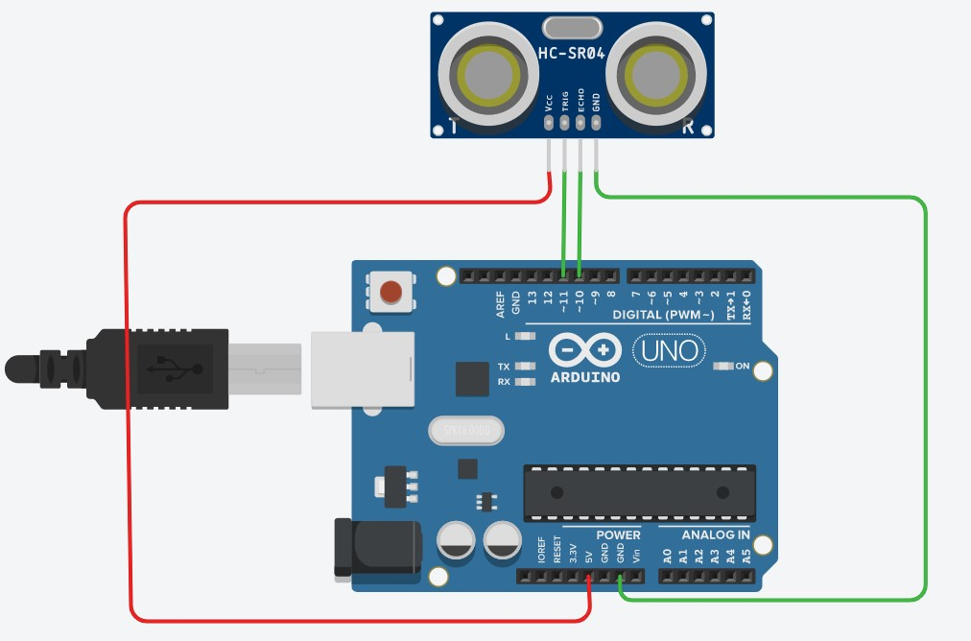
Circuit Diagram for connections

Slide 11
Code for ultrasonic Sensor
int trigpin=11; //defining trigger pin
int echopin=10; //defining echopin
void setup()
{
pinMode(11,OUTPUT); //trigger pin is output pins
pinMode(10,INPUT); //echopin is input pin
Serial.begin(9600); //setting up serial monitor
}
void loop()
{
digitalWrite(trigpin,LOW);
delayMicroseconds(10);
digitalWrite(trigpin,HIGH); //creates US bursts
delayMicroseconds(10);
digitalWrite(trigpin,LOW);
int time=pulseIn(echopin,HIGH); //measuring time
Serial.println(time*0.0165); //look below
delay(10); //delay for 10 milliseconds
}
// The pulseIn measures time duration in microseconds hence we need to multiply 10⁻⁶ but we need to measure the distance in cm hence we need to multiply by 10² and we have traversed twice the distance hence we need to divide by 2.
We are taking the speed of sound approximately equal to 330m/s. Hence we get the factor of 0.0165.

Slide 12
Conceptualizing a Radar BOT
Which sensors would be used?
Servos
Ultrasonic
Buzzer

Slide 13
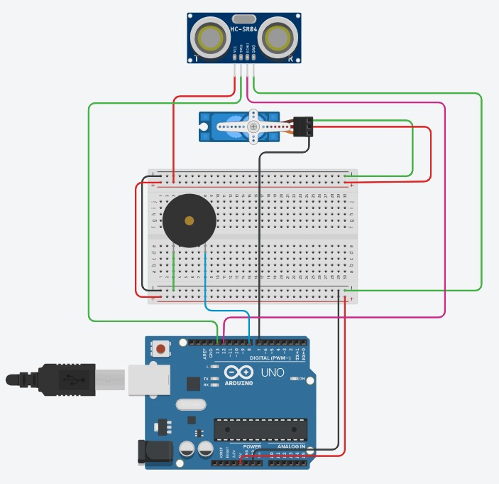
Circuit diagram for connections:-

Slide 14
Code:-
#include<Servo.h>
Servo s;
int pos;
int trigpin=13;
int echopin=12;
double d;
double findDistance() //creating
{ // function
digitalWrite(13,LOW);
delayMicroseconds(10);
digitalWrite(13,HIGH);
delayMicroseconds(10);
digitalWrite(13,LOW);
int time=pulseIn(echopin,HIGH);
double distance=(0.0165*time);
return(distance);
}
void setup()
{
s.attach(7);
Serial.begin(9600);
pinMode(trigpin,OUTPUT);
pinMode(echopin,INPUT);
}
void loop()
{
for(pos=0;pos<=180;pos++)
{
s.write(pos);
delay(15);
d=findDistance();
Serial.println(d);
if(d<100)
{
tone(8,2000,15);
}}
for(pos=180;pos>=0;pos--)
{
s.write(pos);
delay(15);
d=findDistance();
Serial.println(d);
if(d<100)
{
tone(8,2000,15);
}
}
}

Slide 15
Some extra resources:-
https://www.youtube.com/watch?v=aFHu65LiFok&list=PLGs0VKk2DiYw-L-RibttcvK-WBZm8WLEP&index=31&t=0s - Servo
https://www.youtube.com/watch?v=M-UKXCUI0rE&list=PLGs0VKk2DiYw-L-RibttcvK-WBZm8WLEP&index=54&t=0s - Ultrasonic Sensors
Cheat Code for syntax used in Arduino IDE:-
https://drive.google.com/drive/folders/1tt7mw2VKo9yxoe297-UEN0otq8WT7qaL?usp=sharing

Slide 16
Thank You!

